Slide 1

EE698P: TCAD Simulation Demo
Course Instructor:
Dr. Shubham sahay
Dept. of EE
IIT Kanpur
Speakers:
Sateesh
Bhoogi Satya Swaroop

Slide 2
Outline:
Introduction
ATLAS input and output
Statements and steps followed
Examples

Slide 3
Introduction
TCAD (Technology computer Aided Design) is a branch of electronic design automation that models semiconductor fabrication and semiconductor device operation.
Device fabrication is a complex process.
If we probe a device we get behaviour of the device (like I-V characteristics and C-V characteristics) but not what is inside the device ( the underlying physics).
TCAD is a solver which solves some differential equations like
Electrostatic equation (poisson equation)
Transport (drift - diffusion) e.t.c.
Simulator is not only to see the thing which is not fabricated but also to know the underlying physics of the device that is fabricated. You can see “inside” the device. Measurements tell you “what” happens, not “why” it happens TCAD provides the “why” answers.
The ITRS roadmap indicates that TCAD can reduce the cost of development cycles by ~30%.
Captures and visualizes theoretical knowledge. You can view information that is difficult or impossible to measure.

Slide 4
ATLAS INPUT AND OUTPUT
DevEdit
(Structure and mesh editor)
Runtime output
Structure file
Athena
(Process simulator)
Atlas device simulator
Logs file
Tonyplot
(Visualization tool)
Command file
Deckbuild
(Run time environment)
Solution file

Slide 5
Statements and steps followed
Group | Statements
Structure specification | Mesh
 | Region
 | Electrode
 | Doping
Material Model Specification | Material
 | Model
 | contact
 | Interface
Numerical Method Selection | Method
Solution Specifications | Log file
 | load
 | Save
Result Analysis | Tony Plot

Slide 6
Contd…
Mesh - define a structure in terms of location and spacing. Simulator will calculate current, voltage etc. parameter at each mesh point. The finer the meshing, simulation will take more time.
Region - define the complete structure by dividing into the region
Electrode - gate ,source ,drain
Doping - doping concentration, p-type ,n-type, linear, guassian
Material - material used for making substrate,gate,source etc (silicon ,oxide,nitride)
Models - use different model like fermidirac
Contact -define contact with with workfunction
Interface - dynasonos for tunneling
Method - convergence method like newton , gummel
Log file -command for generating log file
Solve -solve the parameter at applied input
Save -save the results
Extract - extract the data from files
Tonyplot –use to make plot in tonyplot

Slide 7
Example: Nitride charging dependance on capture cross section area in SONOS(silicon oxide nitride oxide silicon)
Approach:
Introduce silicon nitride in gate stack
In and out current for different capture cross section area
Use tonyplot to view trapped insulator charge, electron charging rate and other characteristics

Slide 8
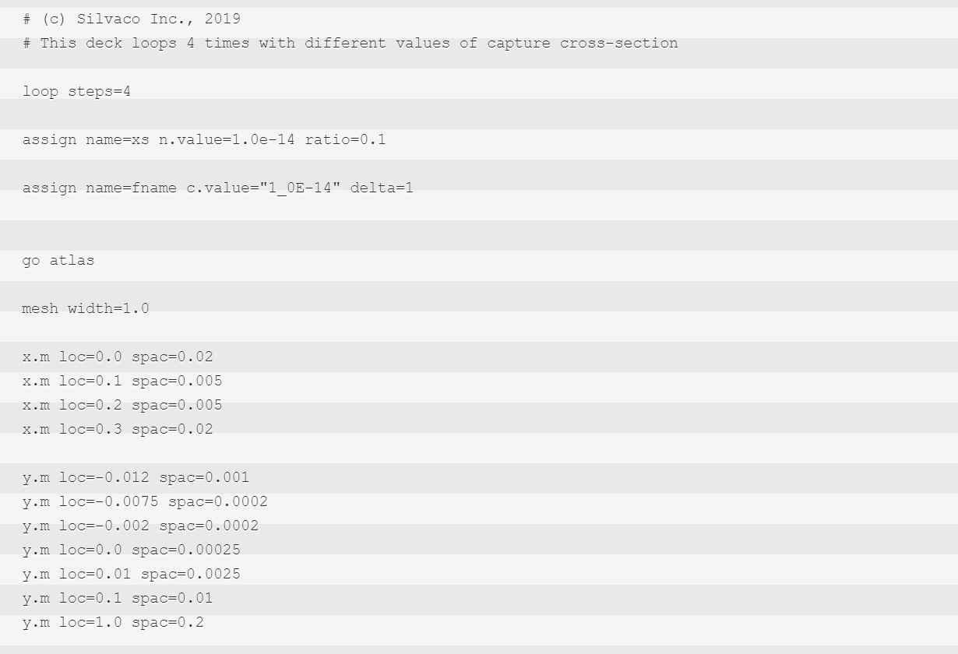
Code:
Run 4 times
Defining the capture cross section area
Width in z axis
Meshing in x axis
Meshing in y axis

Slide 9
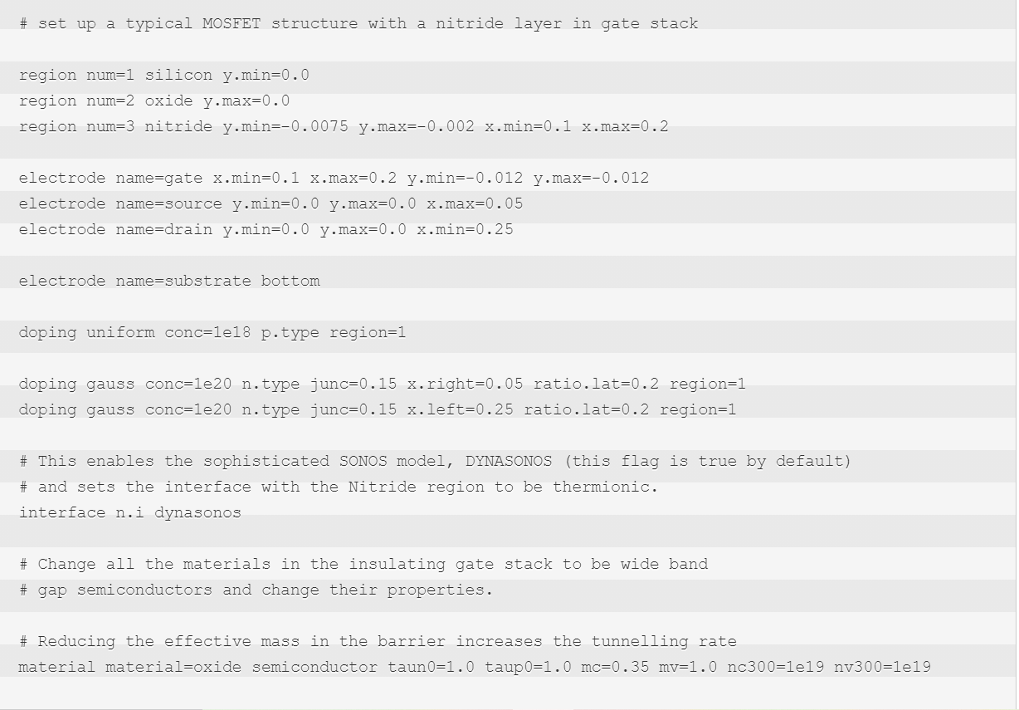
Defining region
Defining electrode
Defining doping
SONOS model for tunneling
taun0,taup0: e- ,hole recombination lifetime;mc,mv:eff mass for tunneling;nc,nv: density of states

Slide 10
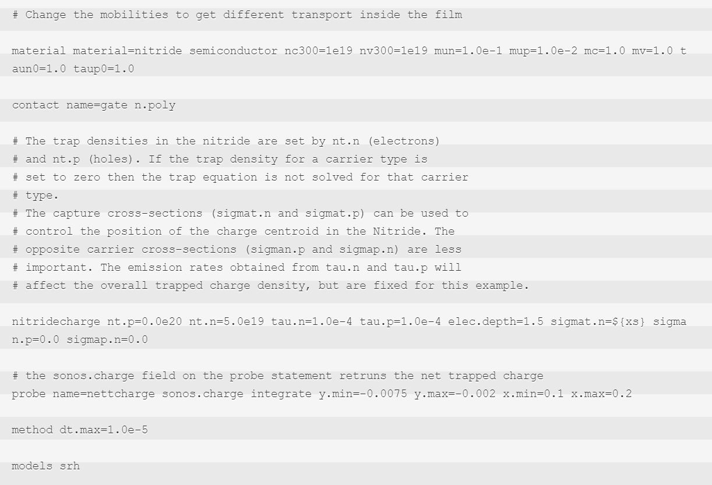
mu: mobility
contact with its work function
elec.depth: energy below conduction band edge of
acceptor traps
nt:trap density ; tau.n: lifetime for e- de-trapping from acceptor state to conduction band
integrating the total charge in nitride layer
max step size in transient mode

Slide 11
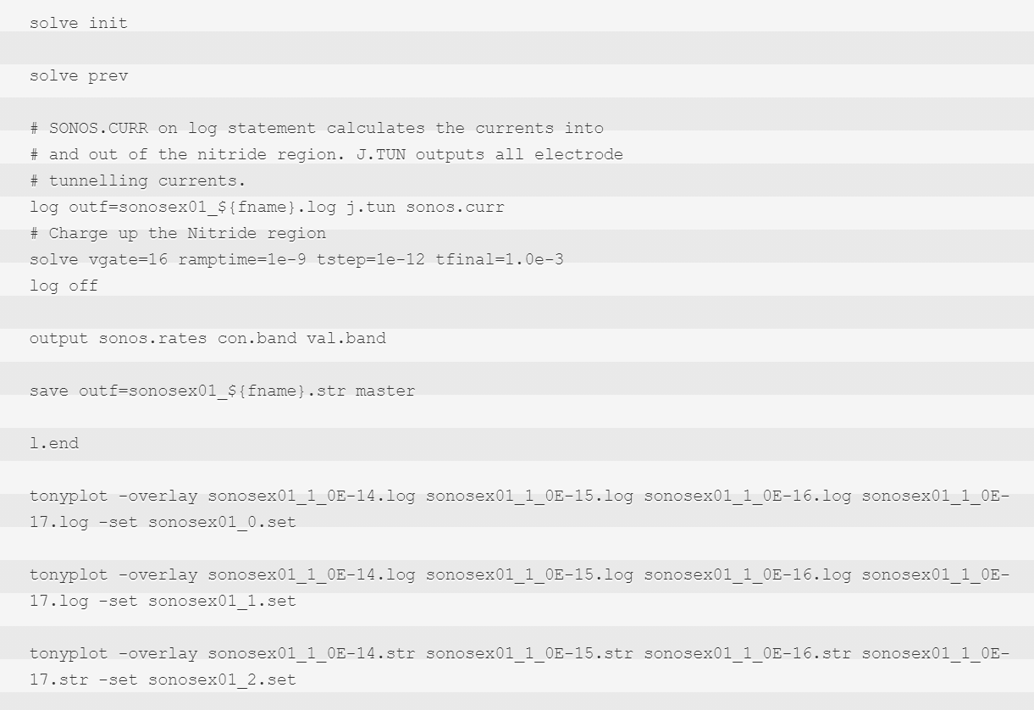
Solve different parameters
generating log files
ramp input
output file and save
Different tonyplot for charge stored, tunneling current,trapped e- conc.

Slide 12
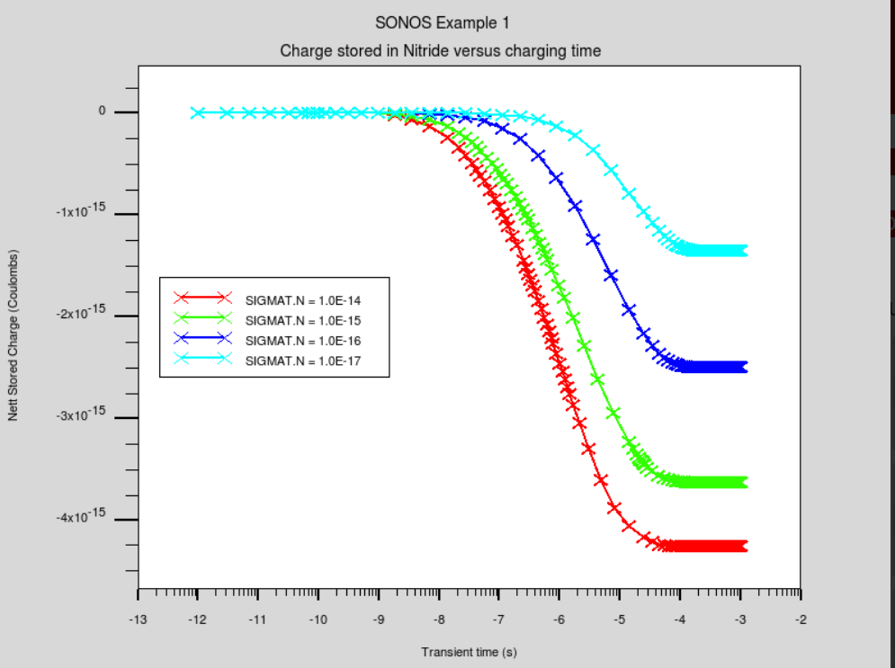
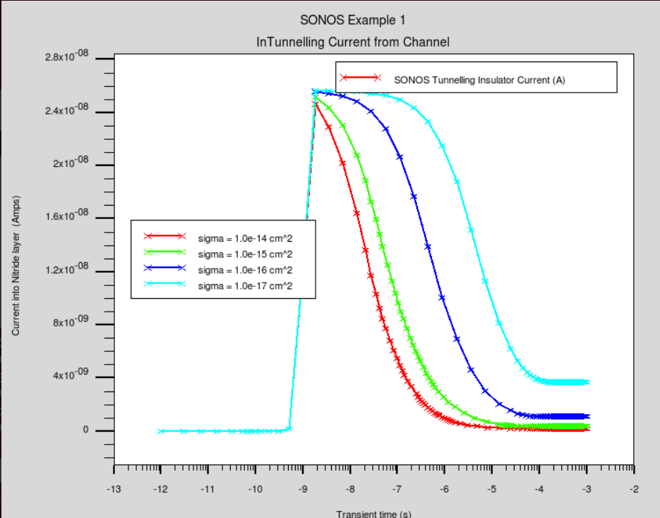

Slide 13
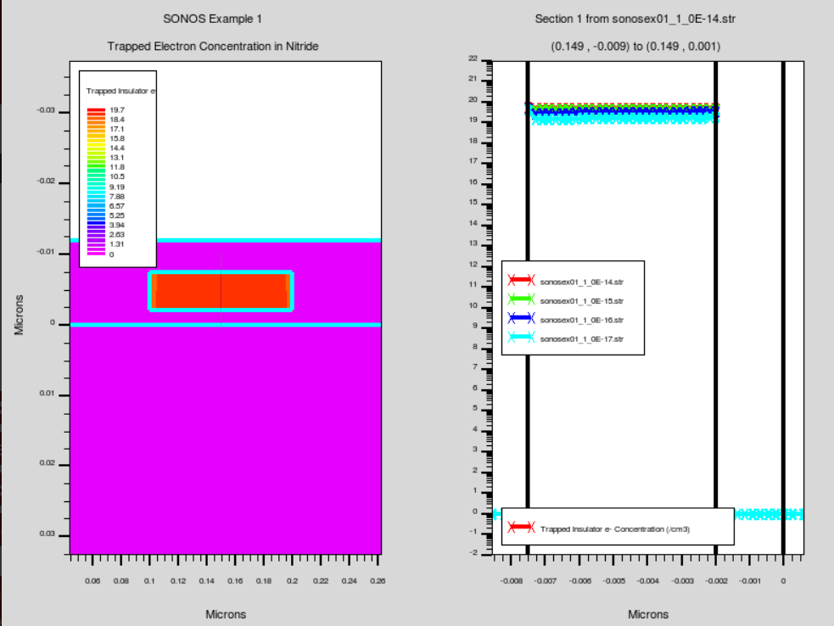

Slide 14
Example 2:Threshold voltage shift for different gate bias and pre-charge time
Define the structure as previous
Define PF barrier. This sets the barrier height for the Poole-Frenkel de-trapping model.
A structure file is saved out at various preset charging times
The threshold voltage increases with Gate Bias and also with charging time
The charge trapped in the Nitride layer affects the threshold voltage in the same way.
For a charging time of 1.0 seconds there is a roughly linear relationship between gate bias and threshold voltage

Slide 15
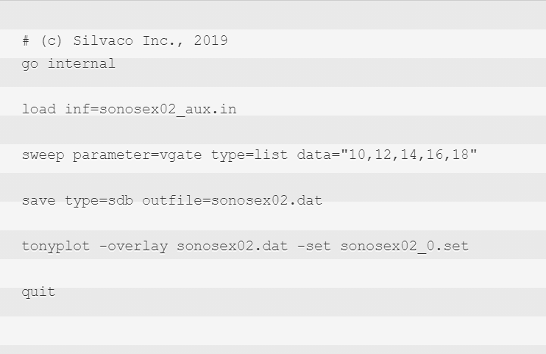
Code:

Slide 16
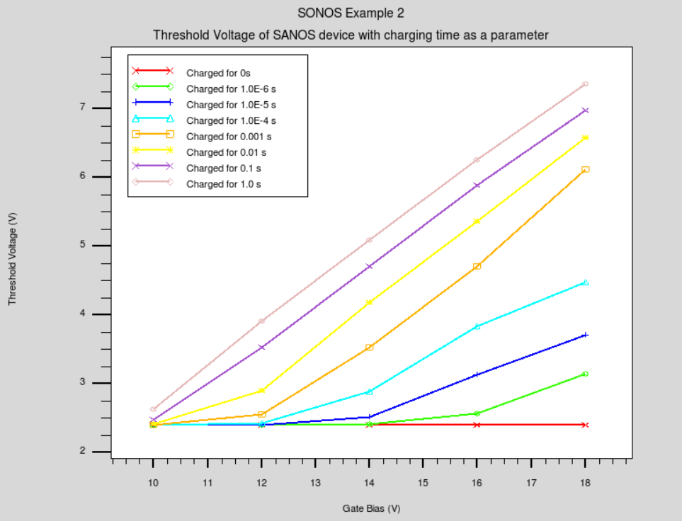

Slide 17
THANK YOU !!!

